Slide 1
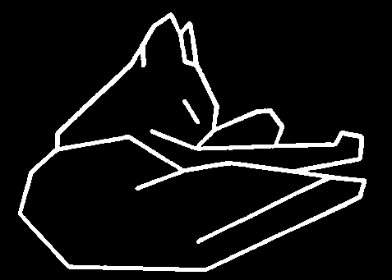
Introduction
CSc 59866/59867 Capstone I/II
Feature Extraction
Zhigang Zhu, City College of New York zhu@cs.ccny.cuny.edu
Notes:
This course is a basic introduction to parts of the field of computer vision. This version of the course covers topics in 'early' or 'low' level vision and parts of 'intermediate' level vision. It assumes no background in computer vision, a minimal background in Artificial Intelligence and only basic concepts in calculus, linear algebra, and probability theory.

Slide 2
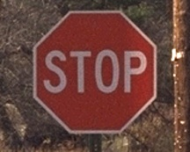





What are Image Features?
Local, meaningful, detectable parts of the image.
Notes:
gradients, colors, foreground, background, edges

Slide 3
Topics
Image Enhancement
Brightness mapping
Contrast stretching/enhancement
Histogram
Noise Reduction
……...
Feature Extraction
Edge detection
Hough Transform

Slide 4
Image Enhancement
Goal: improve the ‘visual quality’ of the image
for human viewing
for subsequent processing
Two typical methods
spatial domain techniques....
operate directly on image pixels
frequency domain techniques....
operate on the Fourier transform of the image
No general theory of ‘visual quality’
General assumption: if it looks better, it is better
Often not a good assumption

Slide 5
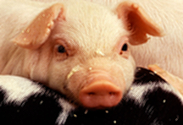

Spatial Domain Methods
T(I(x,y))
neighborhood N
I(x,y)
I’(x,y)
Transformation T
point - pixel to pixel
area - local area to pixel
global - entire image to pixel
Neighborhoods
typically rectangular
typically an odd size: 3x3, 5x5, etc
centered on pixel I(x,y)
Many IP algorithms rely on this basic notion
I’(x,y) = T(I(x,y))
O=T(I)

Slide 6
Point Transforms: General Idea
O = T(I)
Transfer
Function T
Input pixel value, I, mapped to output pixel value, O, via transfer function T.
255
OUTPUT
0
255
INPUT
Notes:
Usually a monotonic function, 1-1 mapping

Slide 7
Point Transforms: Brightness

Slide 8
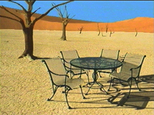
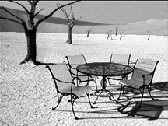
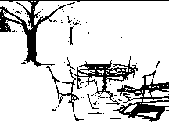
Point Transforms:Thresholding
T is a point-to-point transformation
only information at I(x,y) used to generate I’(x,y)
Thresholding
255
I’(x,y) =
I_{max} if I(x,y) > t
I_{min} if I(x,y) ≤ t
0
0
t
255
t=89

Slide 9
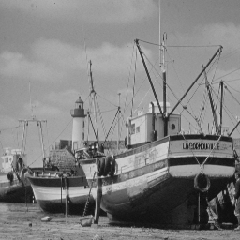
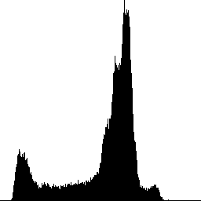
Point Transforms: Linear Stretch
255
OUTPUT
0
INPUT
255

Slide 10
Linear Scaling
Consider the case where the original image only utilizes a small subset of the full range of gray values:
New image uses full range of gray values.
What's F? {just the equation of the straight line}

Slide 11
Linear Scaling
F is the equation of the straight line going through the point (I_{min} , 0) and (I_{max} , K)
useful when the image gray values do not fill the available range.
Implement via lookup tables
Notes:
Slope is m and the I’-intercept is b

Slide 12
Scaling Discrete Images
Have assumed a continuous grayscale.
What happens in the case of a discrete grayscale with K levels?

Slide 13
Non-Linear Scaling: Power Law
γ
O = I
γ < 1 to enhance contrast in dark regions
γ > 1 to enhance contrast in bright regions.
1
γ<1
0
.
5
γ=1
γ>1
0
0
0
.
5
1

Slide 14
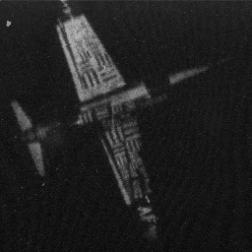
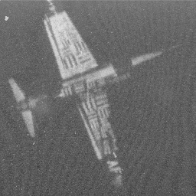
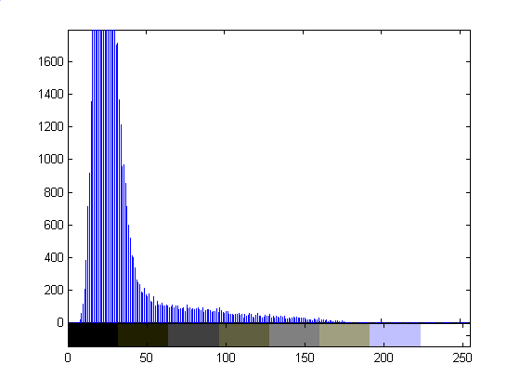
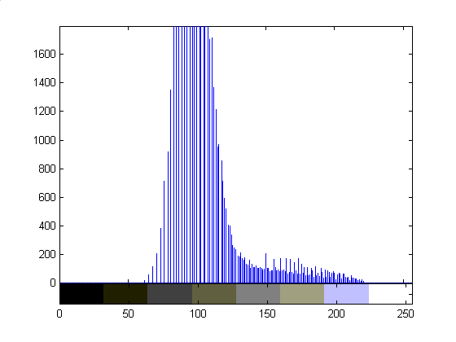
Square Root Transfer: γ=.5

Slide 15
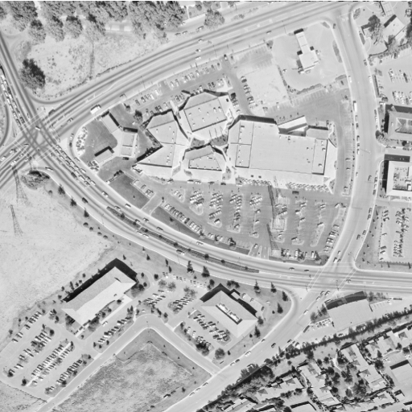
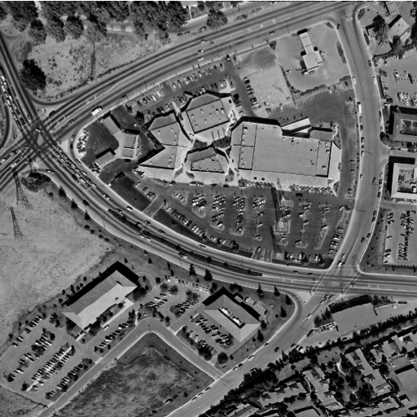
γ=3.0

Slide 16
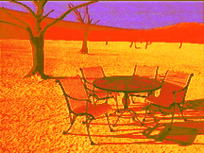
Examples
Technique can be applied to color images
same curve to all color bands
different curves to separate color bands:

Slide 17
Point Transforms:Thresholding
T is a point-to-point transformation
only information at I(x,y) used to generate I’(x,y)
Thresholding
255
I’(x,y) =
I_{max} if I(x,y) > t
I_{min} if I(x,y) ≤ t
0
0
t
255
t=89

Slide 18
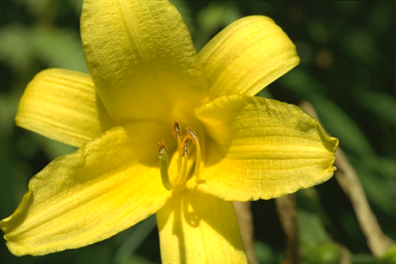
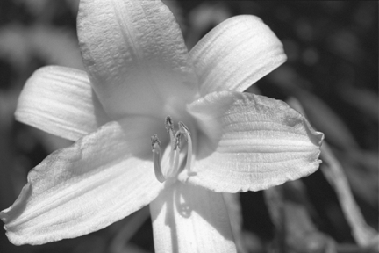

Threshold Selection
Arbitrary selection
select visually
Use image histogram
Threshold

Slide 19
Histograms
The image shows the spatial distribution of gray values.
The image histogram discards the spatial information and shows the relative frequency of occurrence of the gray values.

Slide 20
Image Histogram
The histogram typically plots the absolute pixel count as a function of gray value:
For an image with dimensions M by N

Slide 21
Probability Interpretation
The graph of relative frequency of occurrence as a function of gray value is also called a histogram:
Interpreting the relative frequency histogram as a probability distribution, then:
Σ
P(I(x,y) = i) = H(i)/(MxN)
Σ

Slide 22
Cumulative Density Function
Interpreting the relative frequency histogram as a probability distribution, then:
Curve is called the cumulative distribution function
P(I(x,y) = i) = H(i)/(MxN)
Gray Value

Slide 23
Examples

Slide 24
Color Histograms

Slide 25
Observations
Acquisition process degrades image
Brightness and contrast enhancement implemented by pixel operations
No one algorithm universally useful
γ > 1 enhances contrast in bright images
γ < 1 enhances contrast in dark images
Transfer function for histogram equalisation proportional to cumulative histogram

Slide 26
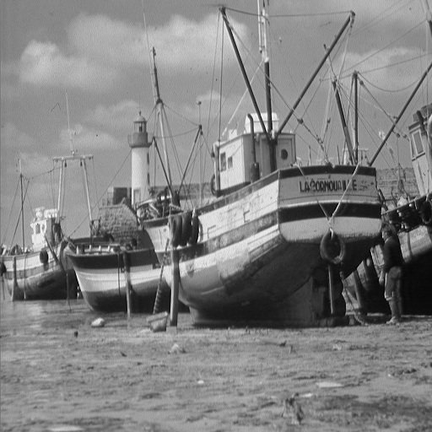
Noise Reduction
What is noise?
How is noise reduction performed?
Noise reduction from first principles
Neighbourhood operators
linear filters (low pass, high pass)
non-linear filters (median)
+
=
image
noise
‘grainy’ image

Slide 27
Noise
Image
Plot of image brightness.
Noise is additive.
Noise fluctuations are rapid
high frequency.
Noise
Image + Noise

Slide 28
Noise
Noise varies above and below uncorrupted image.
Image
Image
+
Noise

Slide 29
Noise Reduction - 1
How do we reduce noise?
Consider a uniform 1-d image and add noise.
Focus on a pixel neighbourhood.
Averaging the three values should result in a value closer to original uncorrupted data
Especially if gaussian mean is zero
A_{i-1} A_{i} A_{i+1}
C_{i}

Slide 30
Noise Reduction - 1
Averaging ‘smoothes’ the noise fluctuations.
Consider the next pixel A_{i+1}
Repeat for remainder of pixels.
A_{i-1} A_{i} A_{i+1} A_{i+2}
C_{i+1}

Slide 31
Neighborhood Operations
All pixels can be averaged by convolving 1-d image A with mask B to give enhanced image C.
Weights of B must equal one when added together.
Why?
C = A * B
B = [ B1 B2 B3 ]
C_{i} = A_{i-1} ×B₁ + A_{i} ×B₂ + A_{i+1} ×B₃
B = [1 1 1]
C_{i} =
1
3
A_{i-1} + A_{i} + A_{i+1}
3

Slide 32


2D Analog of 1D Convolution
Consider the problem of blurring a 2D image
Here’s the image and a blurred version:
How would we do this?
What’s the 2D analog of 1D convolution?

Slide 33
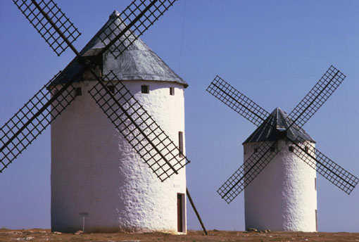

2D Blurring Kernel
C = A * B
B becomes
1 1 1
1 1 1
1 1 1
1
B =
9

Slide 34
Convolution
Extremely important concept in computer vision, image processing, signal processing, etc.
Lots of related mathematics (we won’t do)
General idea: reduce a filtering operation to the repeated application of a mask (or filter kernel) to the image
Kernel can be thought of as an NxN image
N is usually odd so kernel has a central pixel
In practice
(flip kernel)
Align kernel center pixel with an image pixel
Pointwise multiply each kernel pixel value with corresponding image pixel value and add results
Resulting sum is normalized by kernel weight
Result is the value of the pixel centered on the kernel

Slide 35
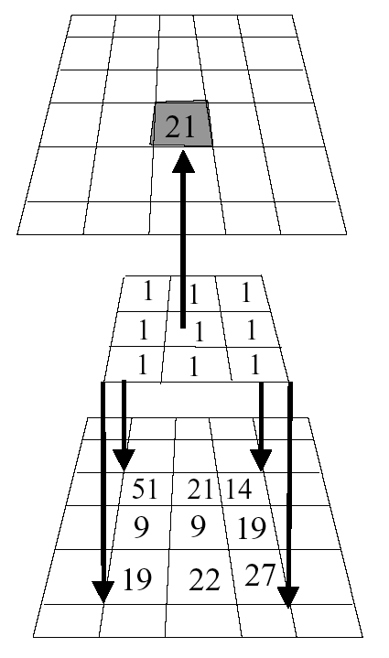
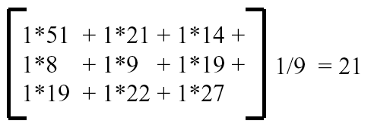
Example
Kernel is aligned with pixel in image, multiplicative sum is computed, normalized, and stored in result image.
Process is repeated across image.
What happens when kernel is near edge of input image?
Result
Image
Kernel
Image

Slide 36
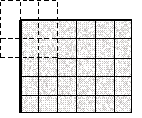
Border Problem
missing samples are zero
missing samples are gray
copying last lines
reflected indexing (mirror)
circular indexing (periodic)
truncation of the result

Slide 37
Convolution Size
Image size = M₁ × N₁
Mask size = M₂ × N₂
N₁
Convolution size =
M₁- M₂ +1 × N₁-N₂+1
N₂
N₁-N₂+1
Typical Mask sizes
= 3×3, 5 ×5, 7×7,
9 ×9, 11×11
What is the convolved
image size for a 128
× 128 image and
7 × 7 mask?

Slide 38
Convolution
= I M
*

Slide 39
Noise Reduction - 1
Image + Noise
Image + Noise - Blurred
Uncorrupted Image

Slide 40
Noise Reduction - 1
Technique relies on high frequency noise fluctuations being ‘blocked’ by filter. Hence, low-pass filter.
Fine detail in image may also be smoothed.
Balance between keeping image fine detail and reducing noise.

Slide 41
Noise Reduction - 1
Saturn image coarse detail
Boat image contains fine detail
Noise reduced but fine detail also smoothed

Slide 42


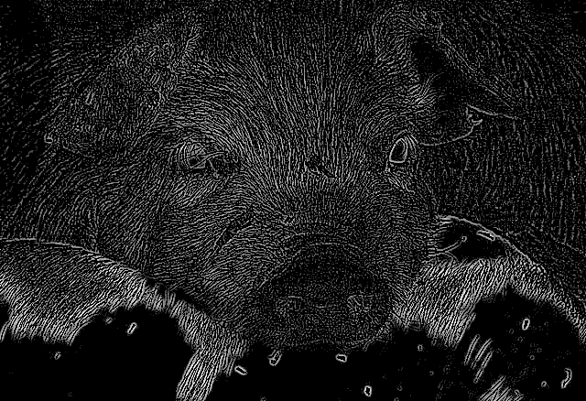
hmmmmm…..
Image
Blurred Image
-
=

Slide 43
Noise Reduction - 2: Median Filter
Nonlinear Filter
Compute median of points in neighborhood
Has a tendency to blur detail less than averaging
Works very well for ‘shot’ or ‘salt and pepper’ noise
Original
Low-pass
Median
Notes:
How does media filter work?
Get data from a window centered at the to-be-processed pixel
Sort the data (from min to max)
Put the median value in the filtered image

Slide 44
Noise Reduction - 2
Low-pass
Median
Low-pass: fine detail smoothed by averaging
Median: fine detail passed by filter

Slide 45
Summary
Summary
Conclusion
What is noise?
Gaussian distribution
Noise reduction
first principles
Neighbourhood
low-pass
median
Averaging pixels corrupted by noise cancels out the noise.
Low-pass can blur image.
Median may retain fine image detail that may be smoothed by averaging.

Slide 46
Topics
Image Enhancement
Brightness mapping
Contrast stretching/enhancement
Histogram
Noise Reduction
……...
Feature Extraction
Edge detection
Hough Transform

Slide 47
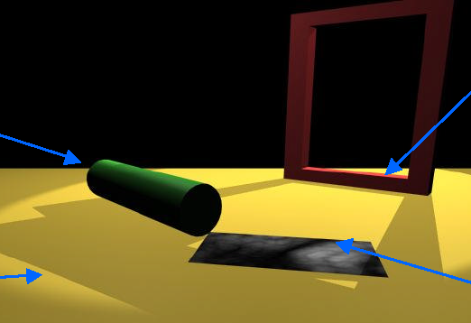
Discontinuities
B
A
C
D
A: Depth discontinuity: abrupt depth change in the world
B: Surface normal discontinuity: change in surface orientation
C: Illumination discontinuity: shadows, lighting changes
D: Reflectance discontinuity: surface properties, markings

Slide 48
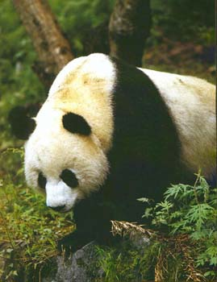
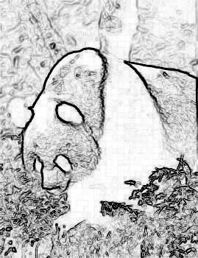
Goal
Devise computational algorithms for the extraction of significant edges from the image.
What is meant by significant is unclear.
Partly defined by the context in which the edge detector is being applied

Slide 49
Edgels
Define a local edge or edgel to be a rapid change in the image function over a small area
implies that edgels should be detectable over a local neighborhood
Edgels are NOT contours, boundaries, or lines
edgels may lend support to the existence of those structures
these structures are typically constructed from edgels
Edgels have properties
Orientation
Magnitude
Position

Slide 50
Feature Extraction
First order edge detectors (lecture - required)
Mathematics
1x2, Roberts, Sobel, Prewitt
Hough Transform – detect by voting
Lines (*)
Circles
Other shapes

Slide 51
Locating Edgels
Rapid change in image => high local gradient => differentiation
f(x) = step edge
1st Derivative f ’(x)
maximum
2nd Derivative -f ’’(x)
zero crossing

Slide 52
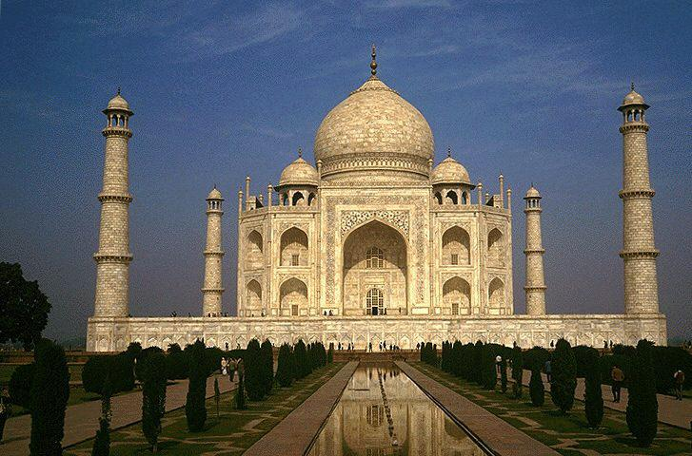
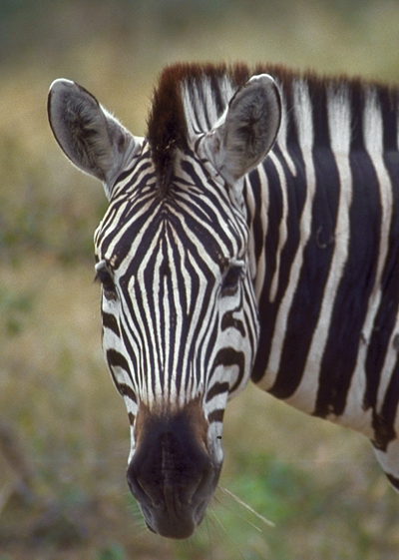
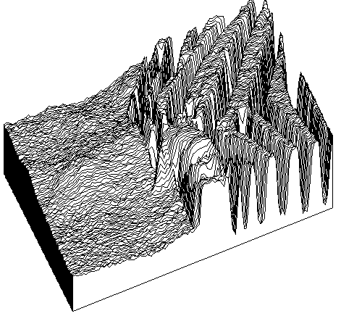
Reality

Slide 53



Properties of an Edge
Original
Orientation
Orientation
Position
Magnitude

Slide 54
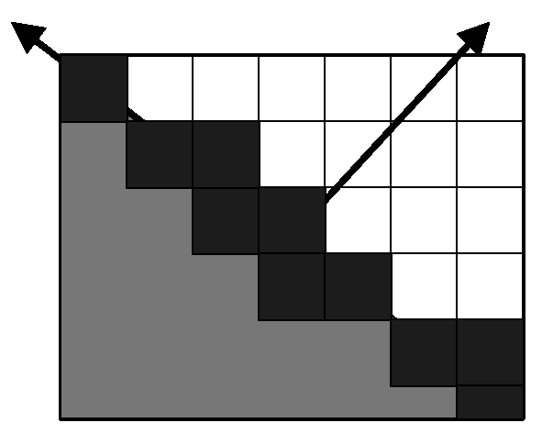
Quantitative Edge Descriptors
Edge Orientation
Edge Normal - unit vector in the direction of maximum intensity change (maximum intensity gradient)
Edge Direction - unit vector perpendicular to the edge normal
Edge Position or Center
image position at which edge is located (usually saved as binary image)
Edge Strength / Magnitude
related to local contrast or gradient - how rapid is the intensity variation across the edge along the edge normal.

Slide 55
Edge Degradation in Noise
Increasing noise
Ideal step edge
Step edge + noise

Slide 56
Real Image

Slide 57
Edge Detection: Typical
Noise Smoothing
Suppress as much noise as possible while retaining ‘true’ edges
In the absence of other information, assume ‘white’ noise with a Gaussian distribution
Edge Enhancement
Design a filter that responds to edges; filter output high are edge pixels and low elsewhere
Edge Localization
Determine which edge pixels should be discarded as noise and which should be retained
thin wide edges to 1-pixel width (nonmaximum suppression)
establish minimum value to declare a local maximum from edge filter to be an edge (thresholding)

Slide 58
Gradient Methods
F(x)
Edge= sharp variation
x
F’(x)
Large first derivative
x

Slide 59
Gradient of a Function
Assume f is a continuous function in (x,y). Then
are the rates of change of the function f in the x and y directions, respectively.
The vector (Δ_{x}, Δ_{y}) is called the gradient of f.
This vector has a magnitude:
and an orientation:
θ is the direction of the maximum change in f.
S is the size of that change.
Δ_{y}
θ = tan⁻¹ ( )
Δ_{x}

Slide 60
Geometric Interpretation
But
I(i,j) is not a continuous function.
Therefore
look for discrete approximations to the gradient.

Slide 61
Discrete Approximations
df(x)
f(x + Δx) - f(x)
f(x)
= lim
dx
Δx
Δx 0
df(x)
f(x) - f(x-1)
dx
≅
1
x-1
x
Convolve with -1 1

Slide 62
In Two Dimensions
Discrete image function I
Derivatives Differences
-1
Δ_{j}I =
-1 1
Δ_{i}I =
1

Slide 63
1x2 Example
1x2 Vertical
Combined
1x2 Horizontal

Slide 64
Smoothing and Edge Detection
Derivatives are 'noisy' operations
edges are a high spatial frequency phenomenon
edge detectors are sensitive to and accent noise
Averaging reduces noise
spatial averages can be computed using masks
Combine smoothing with edge detection.

Slide 65
Effect of Blurring
Original
Orig+1 Iter
Orig+2 Iter
Image
Edges
Thresholded
Edges

Slide 66
Combining the Two
Applying this mask is equivalent to taking the difference of averages on either side of the central pixel.

Slide 67
Many Different Kernels
Variables
Size of kernel
Pattern of weights
1x2 Operator (we’ve already seen this one
-1
Δ_{j}I =
-1 1
Δ_{i}I =
1

Slide 68
Roberts Cross Operator
Does not return any information about the orientation of the edge
S =
[ I(x, y) - I(x+1, y+1) ]² + [ I(x, y+1) - I(x+1, y) ]²
or
S =
| I(x, y) - I(x+1, y+1) | + | I(x, y+1) - I(x+1, y) |
1 0
0 -1
0 1
-1 0
+

Slide 69
Sobel Operator
-1 -2 -1
0 0 0
1 2 1
-1 0 1
-2 0 2
-1 0 1
S₁=
S₂ =
Edge Magnitude =
2
2
S₁ + S₂
S₁
Edge Direction =
tan⁻¹
S₂
Notes:
S1, S2 represent response to the kernels. Not the kernel themselves

Slide 70
Anatomy of the Sobel
1/4
+
Sobel kernel is separable!
1/4
Averaging done parallel to edge
Notes:
Explain how this is done.

Slide 71
Prewitt Operator
-1 -1 -1
0 0 0
1 1 1
-1 0 1
-1 0 1
-1 0 1
P₁=
P₂ =
Edge Magnitude =
2
2
P₁ + P₂
P₁
Edge Direction =
tan⁻¹
P₂
Notes:
P1, P2 represent response, not the kernels

Slide 72
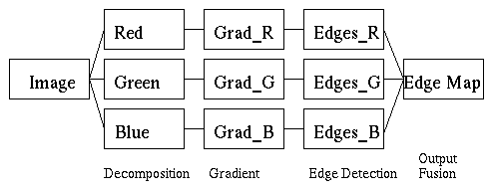
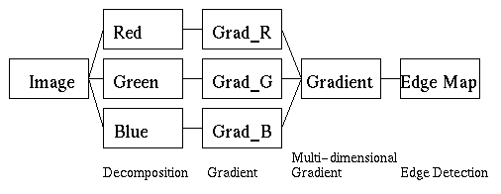
Color Edge Detection
Typical Approaches
Fusion of results on R, G, B separately
Multi-dimensional gradient methods
Vector methods
Color signatures: Stanford (Rubner and Thomasi)

Slide 73
From Edgels to Lines
Given local edge elements:
Can we organize these into more 'complete' structures, such as straight lines?
Group edge points into lines?
Consider a fairly simple technique...

Slide 74
Edgels to Lines
Given a set of local edge elements
With or without orientation information
How can we extract longer straight lines?
General idea:
Find an alternative space in which lines map to points
Each edge element 'votes' for the straight line which it may be a part of.
Points receiving a high number of votes might correspond to actual straight lines in the image.
The idea behind the Hough transform is that a change in representation converts a point grouping problem into a peak detection problem

Slide 75
Edgels to Lines
Consider two (edge) points, P(x,y) and P’(x’,y’) in image space:
The set of all lines through P=(x,y) is y=mx + b, for appropriate choices of m and b.
Similarly for P’
But this is also the equation of a line in (m,b) space, or parameter space.
y
L
P '
P
x

Slide 76
Parameter Space
The intersection represents the parameters of the equation of a line y=mx+b going through both (x,y) and (x',y').
The more colinear edgels there are in the image, the more lines will intersect in parameter space
Leads directly to an algorithm
b
L
x,y; x',y' are fixed
1
b = -mx+y
L
2
b’ = -m’x'+y'
m
(m
,b
)

Slide 77
General Idea
General Idea:
The Hough space (m,b) is a representation of every possible line segment in the plane
Make the Hough space (m and b) discrete
Let every edge point in the image plane ‘vote for’ any line it might belong to.

Slide 78
Hough Transform
Line Detection Algorithm: Hough Transform
Quantize b and m into appropriate 'buckets'.
Need to decide what’s ‘appropriate’
Create accumulator array H(m,b), all of whose elements are initially zero.
For each point (i,j) in the edge image for which the edge magnitude is above a specific threshold, increment all points in H(m,b) for all discrete values of m and b satisfying b = -mj+i.
Note that H is a two dimensional histogram
Local maxima in H corresponds to colinear edge points in the edge image.

Slide 79
Quantized Parameter Space
Quantization
b
single votes
two votes
m
The problem of line detection in image space has been transformed into the problem of cluster
detection in parameter space

Slide 80
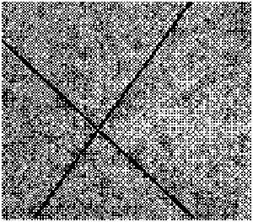
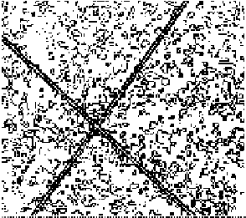
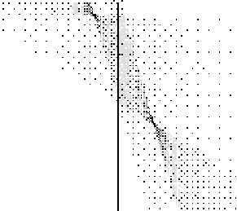

Example
The problem of line detection in image space has been transformed into the problem of cluster detection in parameter space
Image
Edges
Accumulator
Array
Result

Slide 81
Problems
Vertical lines have infinite slopes
difficult to quantize m to take this into account.
Use alternative parameterization of a line
polar coordinate representation
y
r = x cos θ + y sin θ
r
2
θ
r
2
1
θ
1
x

Slide 82
Why?
(r,θ) is an efficient representation:
Small: only two parameters (like y=mx+b)
Finite: 0 ≤ r ≤ √(row²+col²), 0 ≤ θ ≤ 2π
Unique: only one representation per line

Slide 83
Alternate Representation
Curve in (r,θ) space is now a sinusoid
but the algorithm remains valid.
r
r
1
=
x
1
cos
θ
+
y
1
sin
θ
r
2
=
x
2
cos
θ
+
y
2
sin
θ
2
θ
π

Slide 84
Example
y
P
2
P
P = (4, 4)
1
1
r
P = (-3, 5)
2
θ
x
(
r,
θ
)

Slide 85
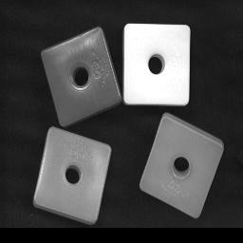
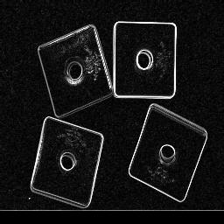
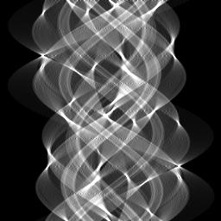
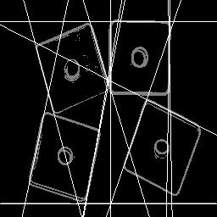
Real Example
Image
Edges
Accumulator
Array
Result

Slide 86
Summary
Image Enhancement
Brightness mapping
Contrast stretching/enhancement
Histogram
Noise Reduction
……...
Feature Extraction
Edge detection
Hough Transform

